Slide 1

Introduction and demonstration Jordan McElwee & David Green

Slide 2
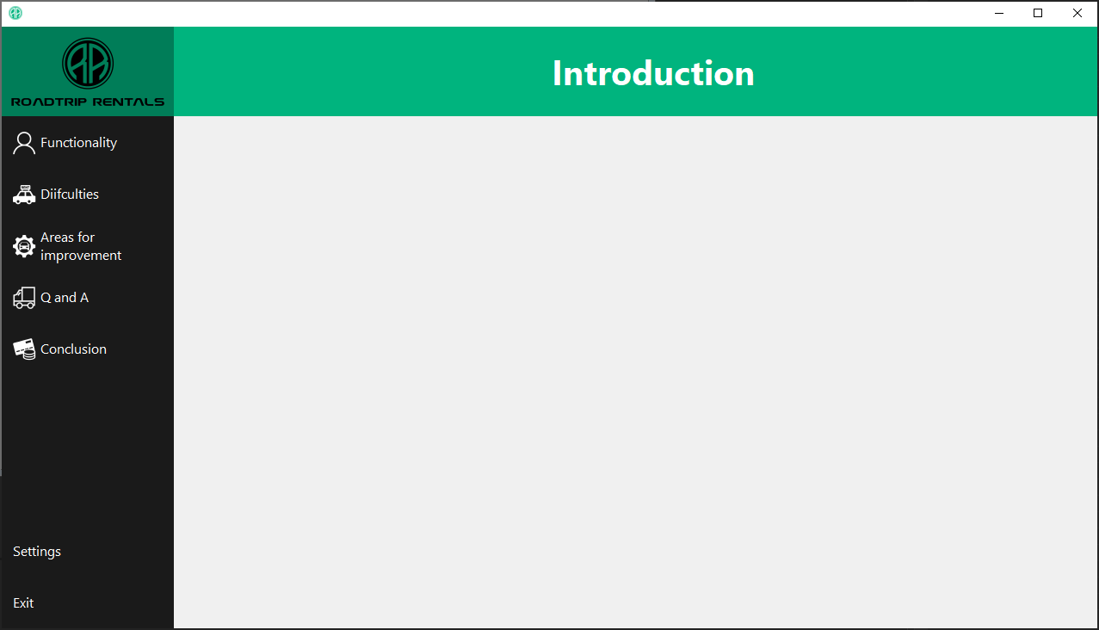
Functionality of Customers, Rentals Suppliers, and Stock
Difficulties
Areas for Improvement
Questions
Notes:
Outlining each of the different sections covered in the presentation, which will cover both individuals

Slide 3
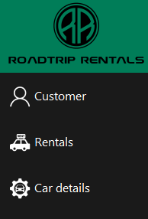
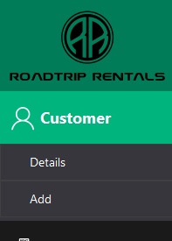
Navigation / UI
Colour scheme
Main menu and submenu
Main Form
Sub forms
Closing sub-forms and application
Efficiency
Notes:
Colour scheme and why
Main menu design
Functionality and importance of menus and submenus
Why subforms were chosen (easier to jump from one place to the next, with better scaling)

Slide 4

Functionality
Demonstration of Application from both project managers
Displaying, adding, editing, and deleting records
Working with multiple tables at once
Validation
Notes:
Functionality aspects done by Jordan and David.
Customer Management
Car Details Management
Rental Management
Supplier Management
Users can access supplier information, including contact details, such as name, street, town, county, postcode, and telephone number
Details can be edited, deleted or new supplier details can be added.
Stock Management:
The application also allows users to manage supplier stock orders, including order dates, delivery dates, and order status.
Users can view order history details and confirm when an order has been deleted, this will then update the ordered cars into the car details table to be used for booking.

Slide 5
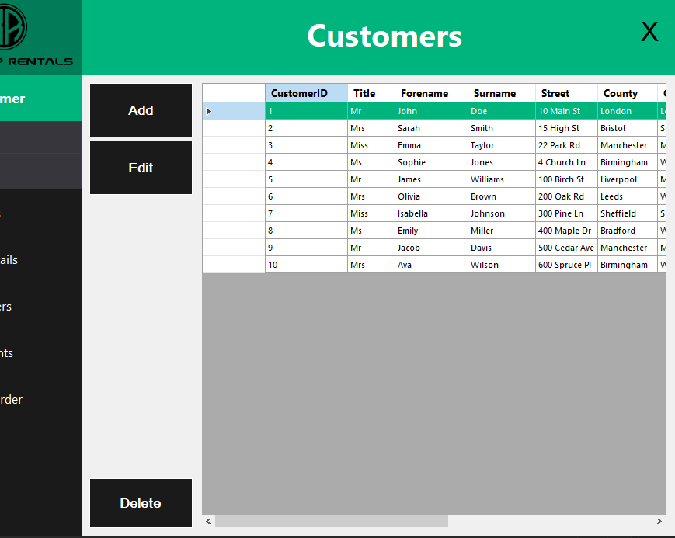
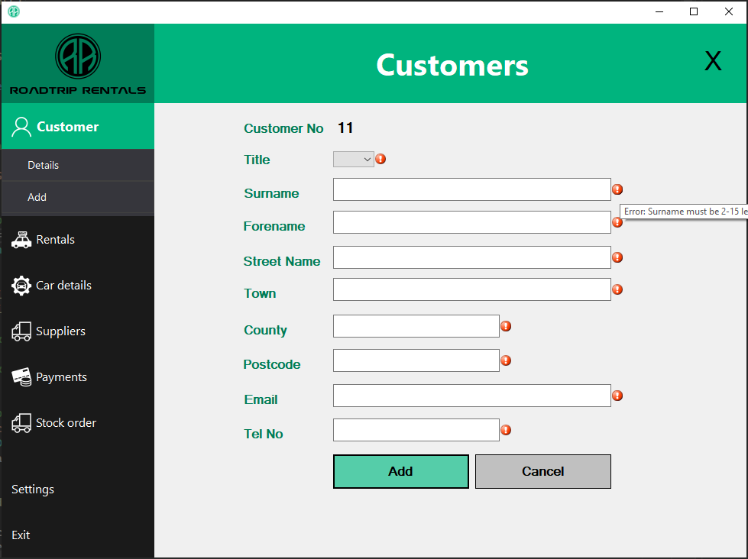
Functionality (Customers)
Displaying
Adding
Editing
Deleting
Notes:
Customer Management:
Users can add new customer records by entering their personal information, including title, forename, surname, address, email, and telephone number, which is validated including visual feedback
Existing customer records can be edited to update any changes in their details.
Customers can also be deleted from the system when necessary.

Slide 6
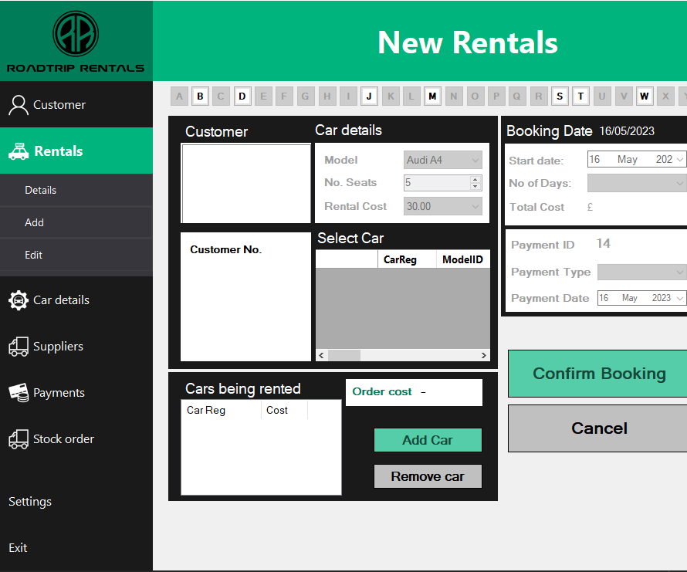
Functionality (Rentals)
Displaying
Adding
Editing
Deleting
Boxes are disabled until a customer is selected, and booking dates disabled until a car is selected
Notes:
Guessing from the name, Rentals is the key aspect of the purpose and benefits of the application
This form incorporates everything the application is built from in terms of data being stored
Customers, Cars, Payments and existing rentals
Navigation and ease of use very key here to enforce functionality

Slide 7
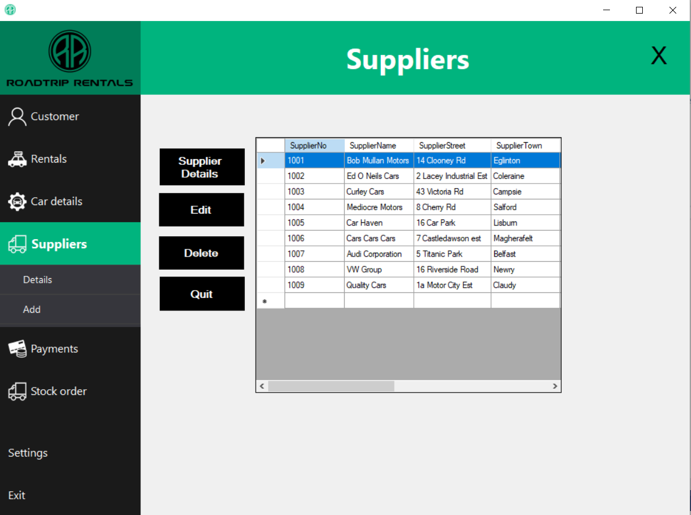
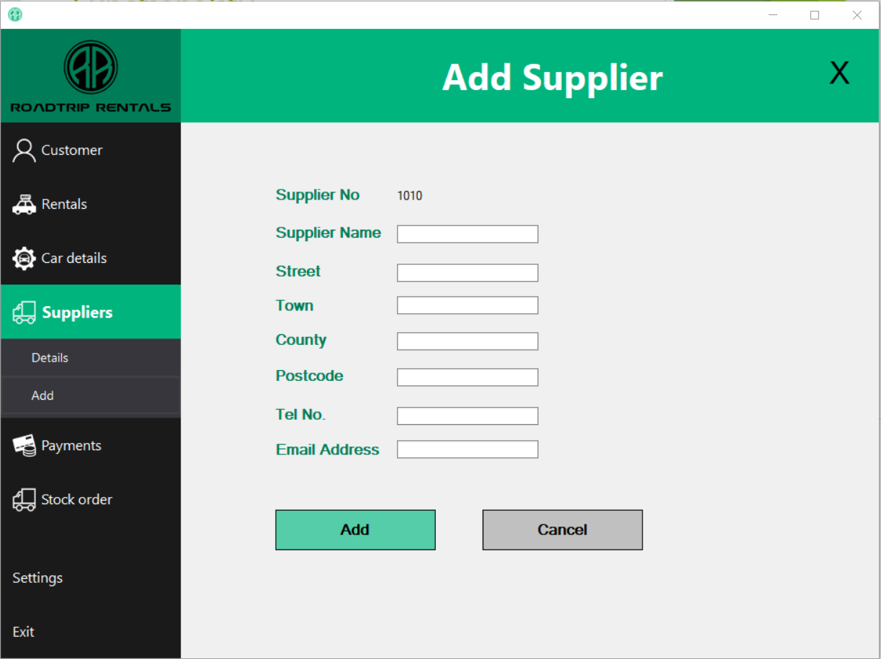
Functionality (Suppliers)

Slide 8
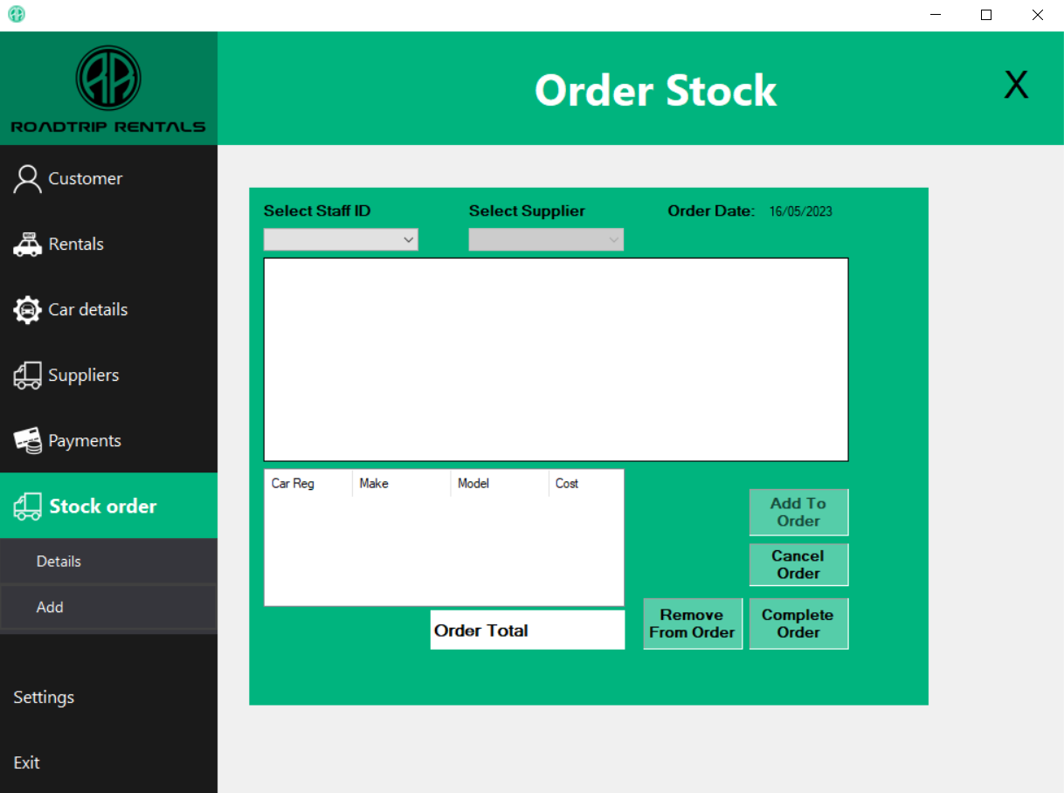
Functionality (Stock)
Supplier combo box stays inactive until Staff ID selected
Add to Order button stays inactive until Supplier selected
Notes:
When in the Order Stock page, the page loads with the Supplier combo box disabled until a Staff ID is selected in the Staff combo box.
The Add to order button is disabled until car is added to the order

Slide 9
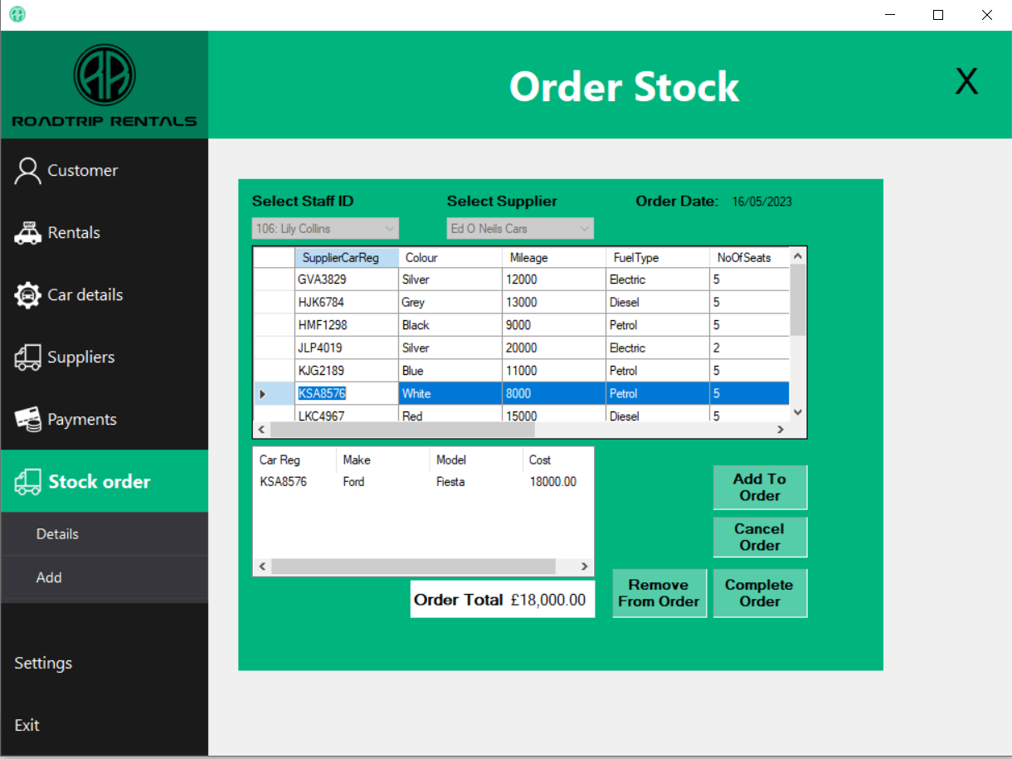
Functionality (Stock)
Combo boxes disable whenever a car is added to order.
Notes:
Both combo boxes disable whenever a car is added to order and will enable if all the cars are removed from the order.
When an order is completed, the details are stored in the order history page.

Slide 10
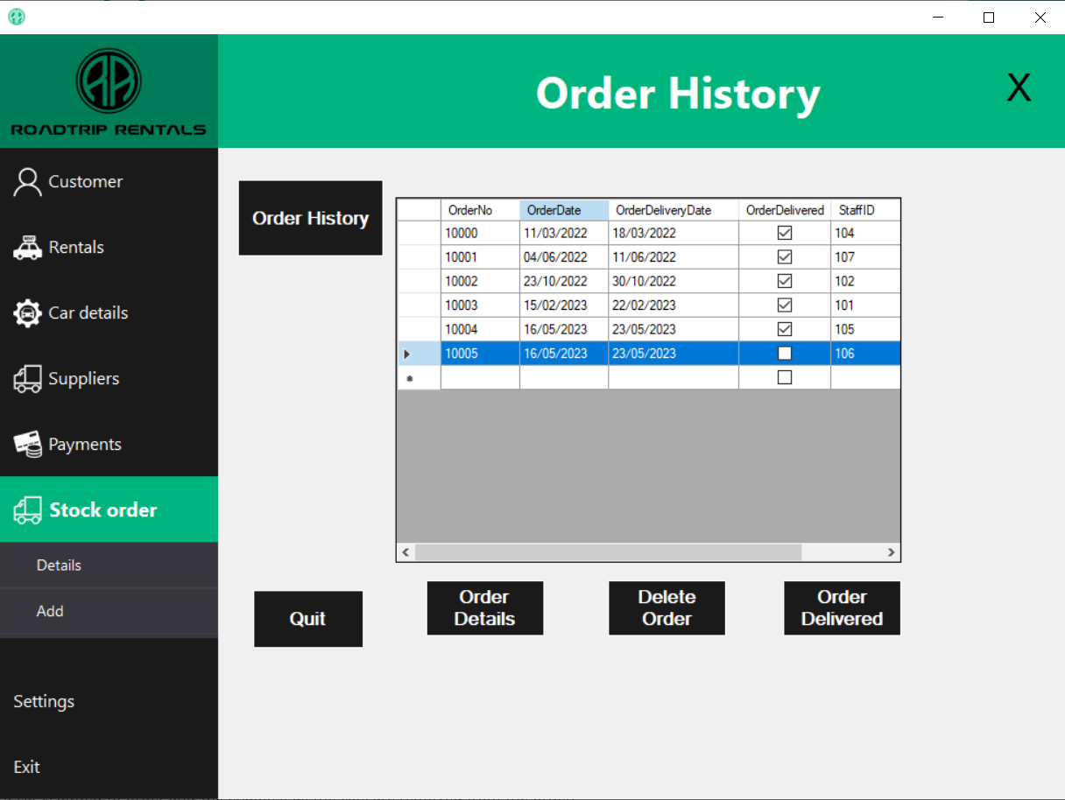
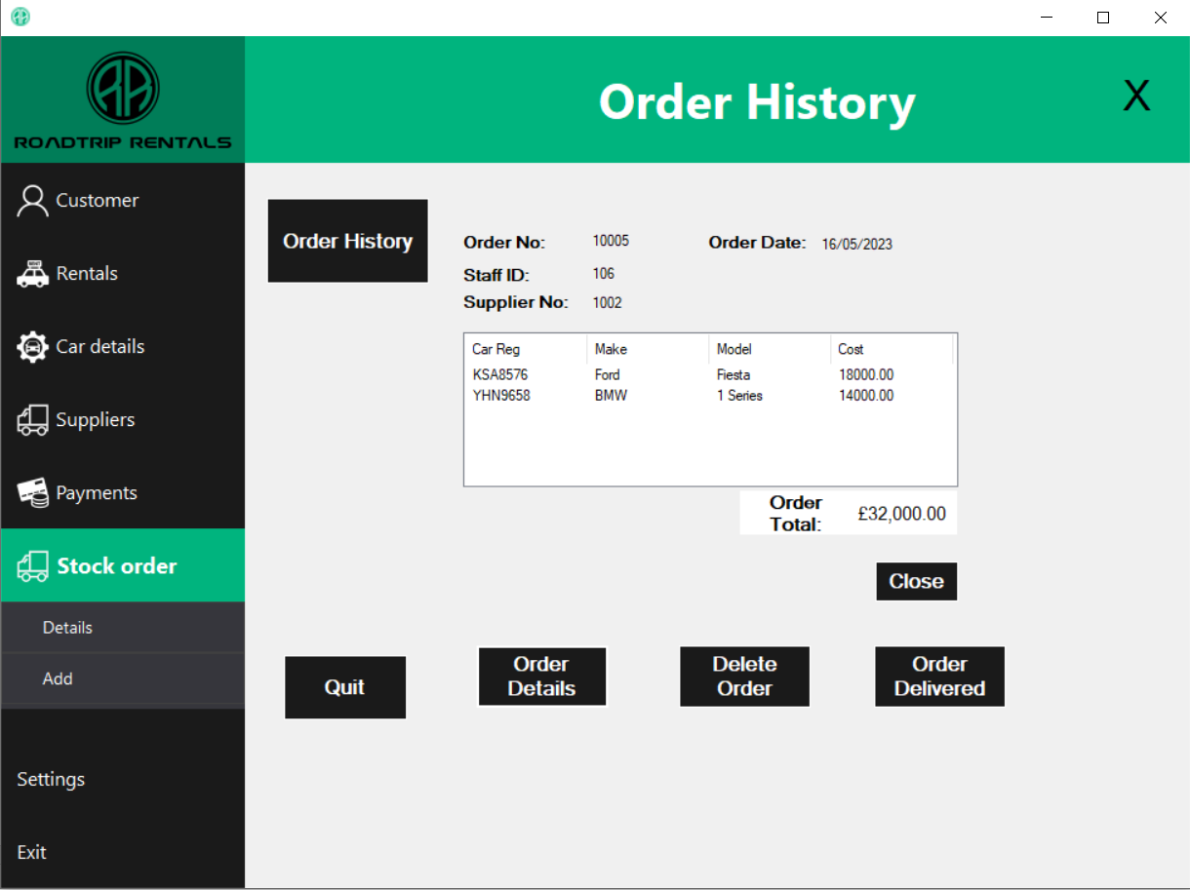
Functionality (Order History)
Notes:
Order History lists all orders placed – clicking on Order details will show all details for that order.
Clicking on Order delivered will update the Car Details table to be used in new Rentals.

Slide 11


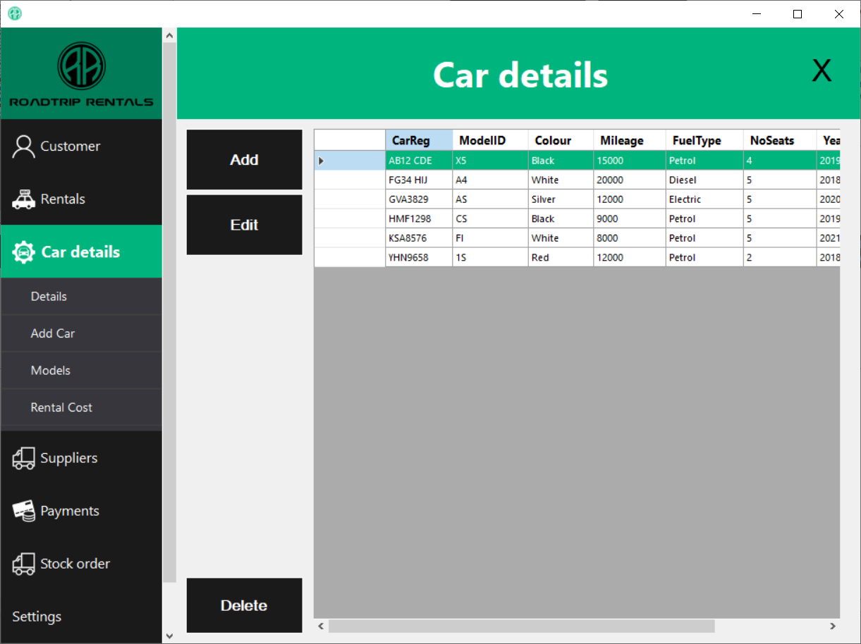
Joint Functionality
Notes:
Talk about the joint functionality between the two sides of the project and how it all comes together to make one coherent application

Slide 12
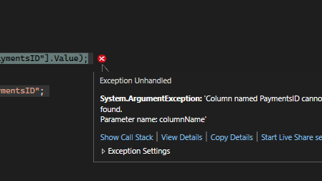
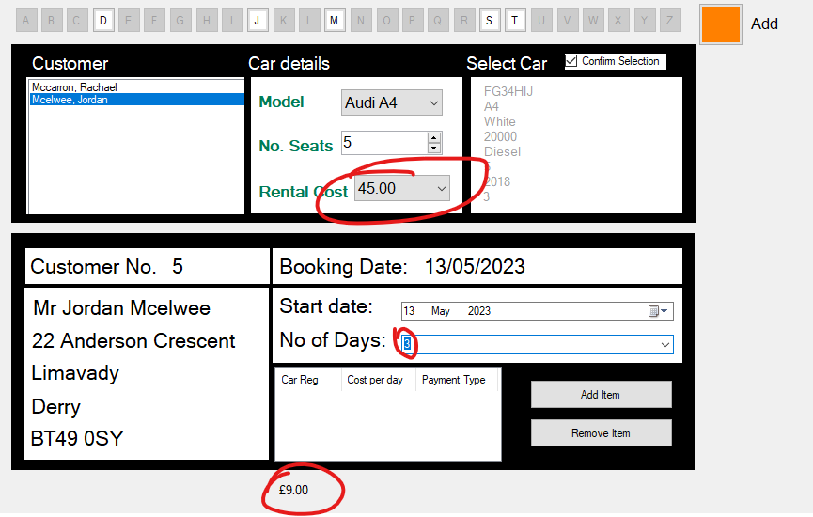
Difficulties encountered
Time management
Database design, table relationships
Calculations
Deleting data tied to other data
Co-operation
GitHub merging (conflicts)
Rental cost calculation not displaying or calculating correctly

Slide 13
Difficulties encountered – David
Unable to delete cars from Supplier Stock table after order – will lose order history details.
Unable to delete supplier with cars attached to them
No edit existing order – added Ordered delivered instead
Issue with updating Car Details table – adding the car more than once.
Tried to display Staff name and Supplier name in order details
Merging issues when joining on GitHub

Slide 14
Areas for improvement – Jordan
Form auto scaling
Add / Edit rental form design
Accessibility features
Tab indexing
Login screen and dashboard
More efficient code and methods
Animation, interactivity
More consistent design between forms

Slide 15
Areas for improvement – David
Make Add/Edit Staff form
Find a fix to delete cars from supplier stock table and still show details in order history
Improve the design of the forms
Improve display of stock within data grid view to see better details of each car

Slide 16

Thank you

